Slide 1

Style Transfer
CS 20: TensorFlow for Deep Learning Research
Lecture 9
2/9/2017

Slide 2
Announcements
Assignment 2 is out. It’s fun, but tricky. Start early.
Sign up for check-ins/IGs with the course staff!
cs20-win1718-staff@lists.stanford.edu

Slide 3


Guest lectures next week
Alec Radford
OpenAI
Topic: GANs
2/9
Danijar Hafner
Google Brain
Topic: Variational Autoencoder
2/14

Slide 4
Agenda
TFRecord
Getting to know each other!
Style Transfer

Slide 5
TFRecord

Slide 6
What’s TFRecord
The recommended format for TensorFlow
Binary file format

Slide 7
What’s TFRecord
The recommended format for TensorFlow
Binary file format
a serialized tf.train.Example protobuf object
Notes:
protobuf: google’s xml-like format

Slide 8
Why binary
make better use of disk cache

Slide 9
Why binary
make better use of disk cache
faster to move around

Slide 10
Why binary
make better use of disk cache
faster to move around
can handle data of different types
e.g. you can put both images and labels in one place

Slide 11
Convert to TFRecord format
Feature: an image
Label: a number

Slide 12
Convert to TFRecord format
# Step 1: create a writer to write tfrecord to that file
writer = tf.python_io.TFRecordWriter(out_file)
# Step 2: get serialized shape and values of the image
shape, binary_image = get_image_binary(image_file)
# Step 3: create a tf.train.Features object
features = tf.train.Features(feature={'label': _int64_feature(label),
'shape': _bytes_feature(shape),
'image': _bytes_feature(binary_image)})
# Step 4: create a sample containing of features defined above
sample = tf.train.Example(features=features)
# Step 5: write the sample to the tfrecord file
writer.write(sample.SerializeToString())
writer.close()

Slide 13
Convert to TFRecord format
# Step 1: create a writer to write tfrecord to that file
writer = tf.python_io.TFRecordWriter(out_file)
# Step 2: get serialized shape and values of the image
shape, binary_image = get_image_binary(image_file)
# Step 3: create a tf.train.Features object
features = tf.train.Features(feature={'label': _int64_feature(label),
'shape': _bytes_feature(shape),
'image': _bytes_feature(binary_image)})
# Step 4: create a sample containing of features defined above
sample = tf.train.Example(features=features)
# Step 5: write the sample to the tfrecord file
writer.write(sample.SerializeToString())
writer.close()
Serialize different data type
into byte strings

Slide 14
Convert to TFRecord format
def _int64_feature(value):
return tf.train.Feature(int64_list=tf.train.Int64List(value=[value]))
def _bytes_feature(value):
return tf.train.Feature(bytes_list=tf.train.BytesList(value=[value]))

Slide 15
Read TFRecord
Using TFRecordDataset

Slide 16
Read TFRecord
dataset = tf.data.TFRecordDataset(tfrecord_files)
dataset = dataset.map(_parse_function)
Parse each tfrecord_file into different features that we want
In this case, a tuple of
(label, shape, image)

Slide 17
Read TFRecord
dataset = tf.data.TFRecordDataset(tfrecord_files)
dataset = dataset.map(_parse_function)
def _parse_function(tfrecord_serialized):
features={'label': tf.FixedLenFeature([], tf.int64),
'shape': tf.FixedLenFeature([], tf.string),
'image': tf.FixedLenFeature([], tf.string)}
parsed_features = tf.parse_single_example(tfrecord_serialized, features)
return parsed_features['label'], parsed_features['shape'], parsed_features['image']

Slide 18
See
08_tfrecord_example.py

Slide 19
Assignment 2:
Style Transfer

Slide 20
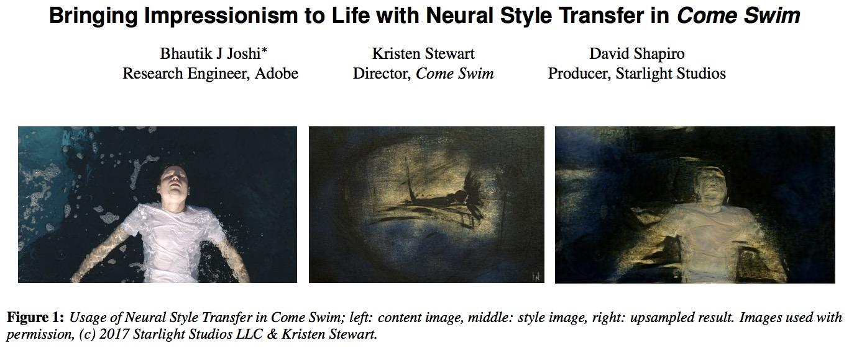

Slide 21
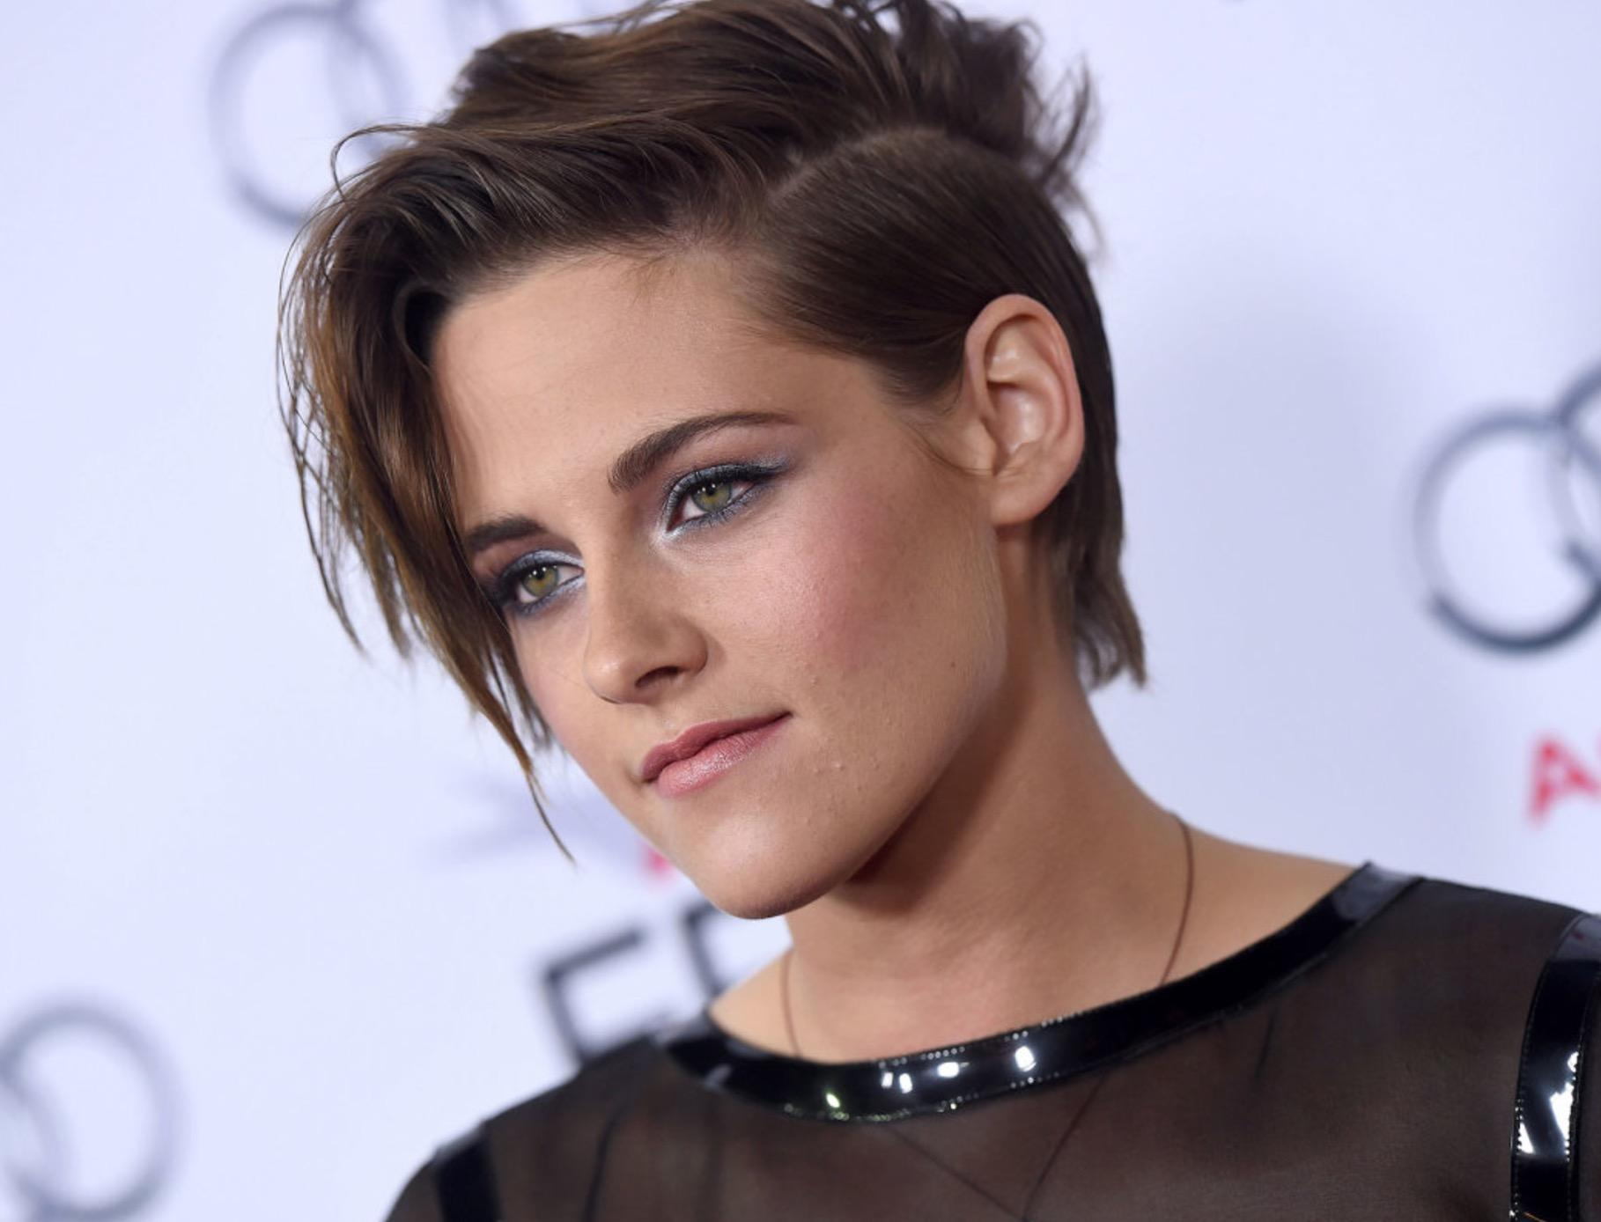
Yes, that Kristen Stewart!
Notes:
She has more citations than I do :(

Slide 22

Deadpool

Slide 23
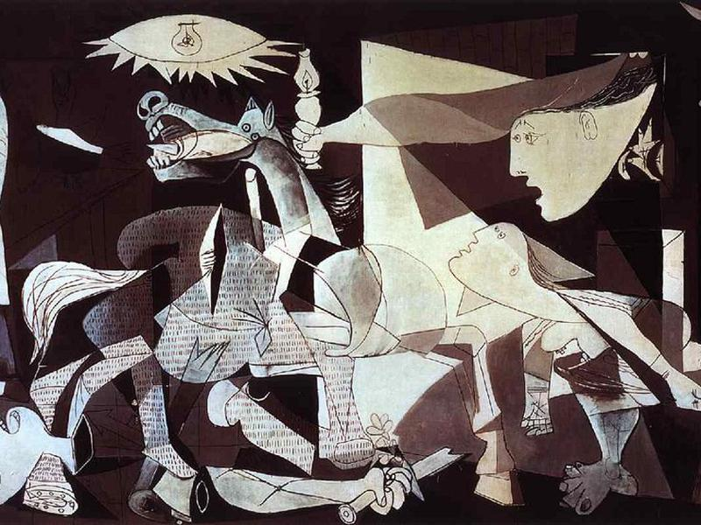
Guernica
Notes:
And that’s exactly what it means in neural networks

Slide 24
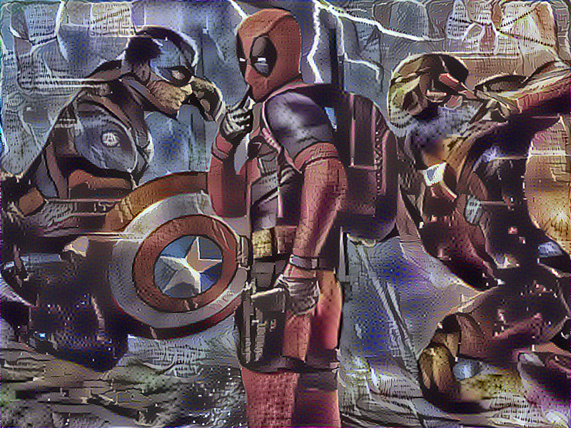
Deadpool and Guernica
Notes:
After 160 iterations

Slide 25
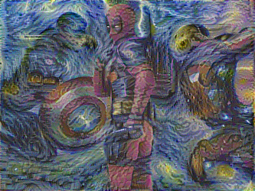
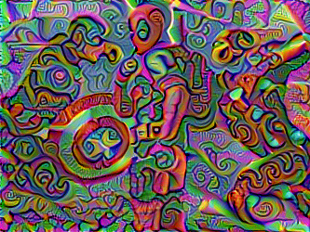
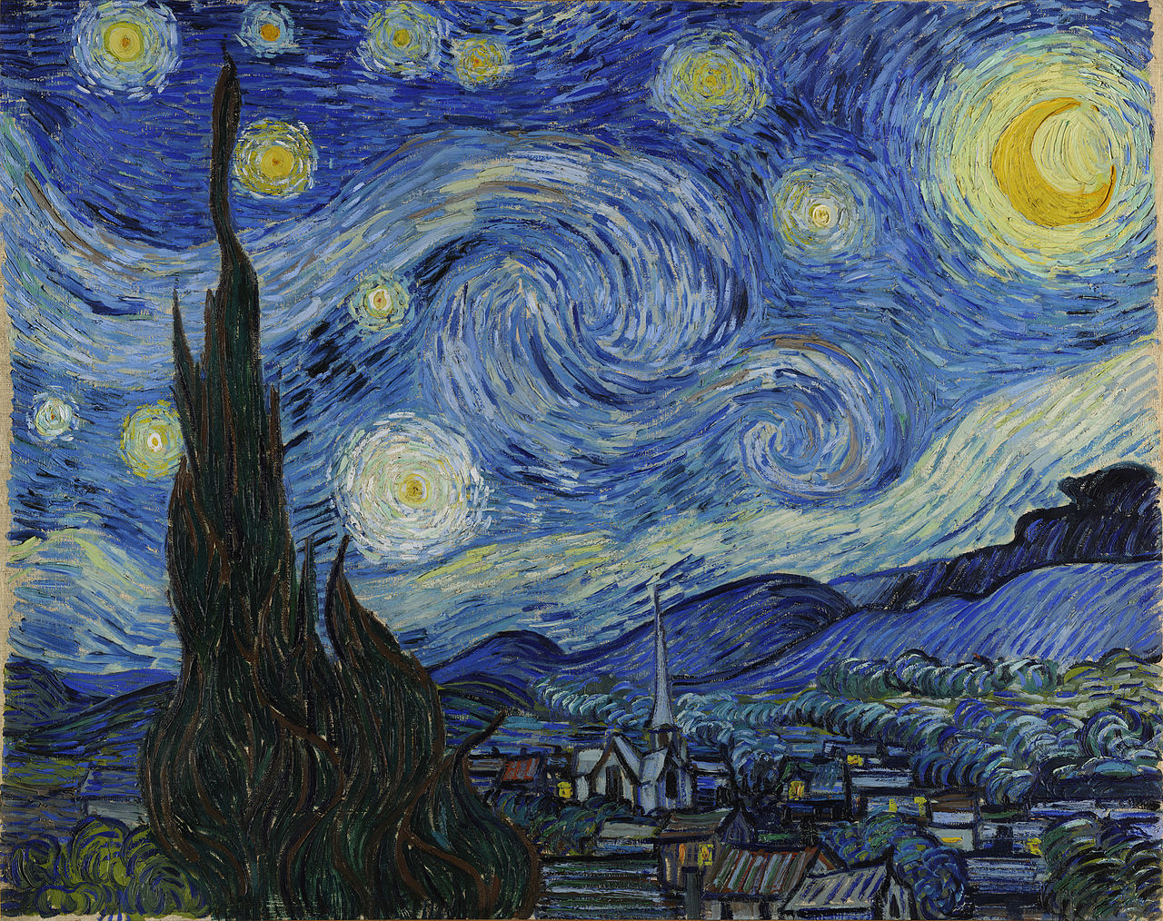
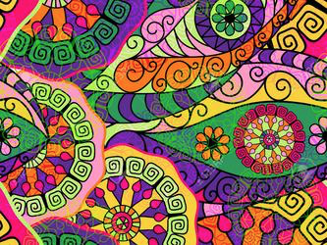
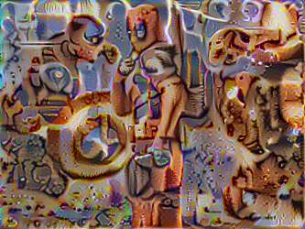
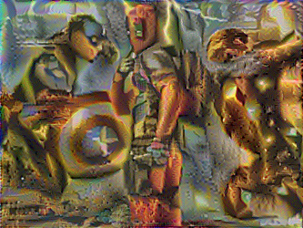
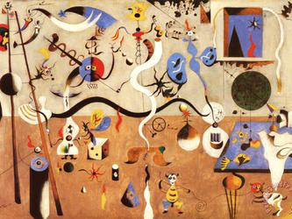
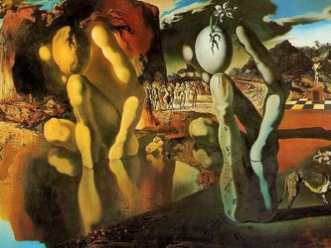

Slide 26
Logan Engstrom’s fast-style-transfer @ GitHub

Slide 27
Style Transfer
The math is aight
but the implementation is tricky

Slide 28
Mathy stuff
Find a new image:
whose content is closest to the content image and
whose style is closest to the style image

Slide 29
It’s all about the loss functions
Content loss
Measure the content loss between the content of the generated image and the content of the content image
Style loss
Measure the style loss between the style of the generated image and the style of the style image

Slide 30


Slide 32
Feature maps
A convolutional network has many layers, each layer is a function that extracts certain features

Slide 33
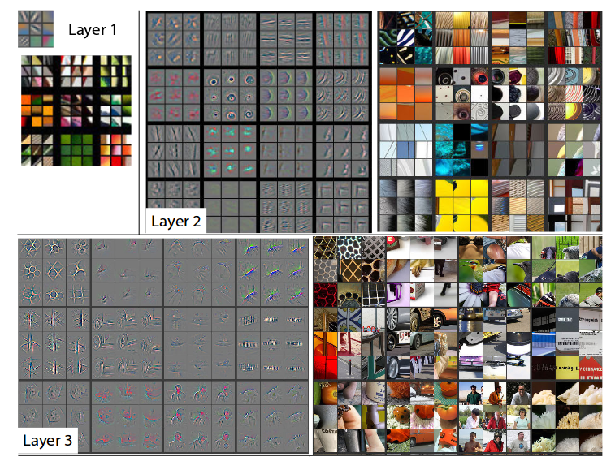
Zeiler, Matthew D., and Rob Fergus. "Visualizing and understanding convolutional networks." European conference on computer vision. Springer, Cham, 2014.
Notes:
A convolutional network has many different layers, each layer is like a function that can extract certain features
A study has shown that lower layers tend to represent

Slide 34
Content/style of an image
Feature visualization have shown that:
lower layers extract features related to content
higher layers extract features related to style

Slide 35
Loss functions revisited
Content loss
Measure the loss between the feature maps in the content layer of the generated image and the content image
Style loss
Measure the loss between the feature maps in the style layers of the generated image and the style image

Slide 36
Loss functions revisited
Content loss
To measure the content loss between the feature map in the content layer of the generated image and the content image
Paper: ‘conv4_4’
Style loss
To measure the style loss between the gram matrices of feature maps in the style layers of the generated image and the style image
Paper: [‘conv1_1’, ‘conv2_1’, ‘conv3_1’, ‘conv4_1’ and ‘conv5_1’]

Slide 37
Loss functions revisited
Content loss
To measure the content loss between the feature map in the content layer of the generated image and the content image
Paper: ‘conv4_4’
Style loss
To measure the style loss between the gram matrices of feature maps in the style layers of the generated image and the style image
Paper: [‘conv1_1’, ‘conv2_1’, ‘conv3_1’, ‘conv4_1’ and ‘conv5_1’]
Weighted sum. Give more weight to deeper layers
E.g. 1.o for ‘conv1_1’, 2.0 for ‘conv2_1’, ...

Slide 38
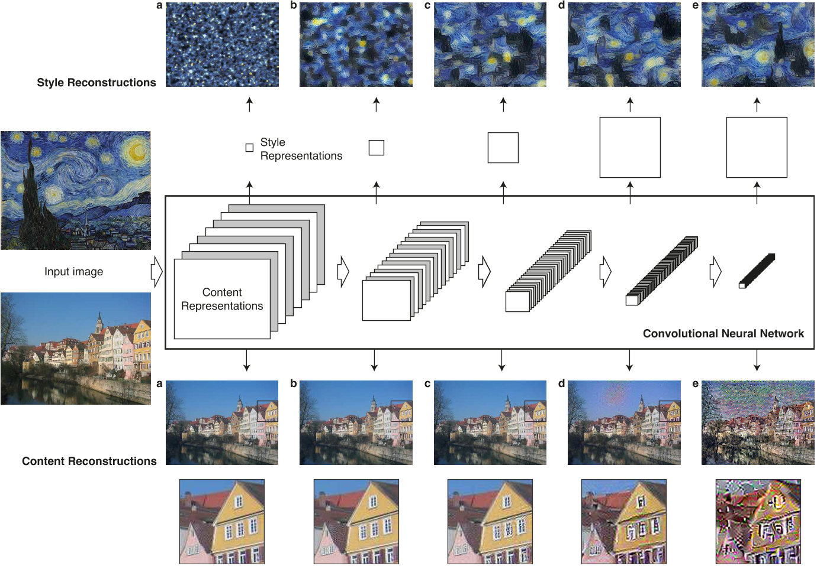
Gatys, Leon A., Alexander S. Ecker, and Matthias Bethge. "A neural algorithm of artistic style." arXiv preprint arXiv:1508.06576 (2015).

Slide 39
How to find these magic feature maps?

Slide 40
Use pretrained weights (functions) such as VGG, AlexNet, GoogleNet
Notes:
VGG: Oxford (Visual Geometry Group)
AlexNet: Toronto
GoogleNet: Google

Slide 41
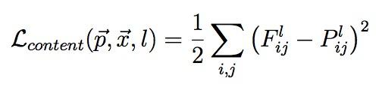
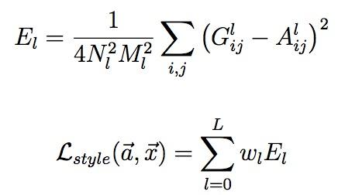
Loss functions revisited
Content loss
Style loss

Slide 42
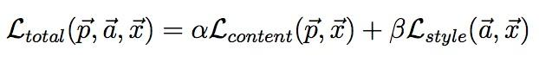
Optimizer
Optimizes the initial image to minimize the combination of the two losses
Do not optimize the weights!

Slide 43
Tricky implementation details
Train input instead of weights

Slide 44
Tricky implementation details
Train input instead of weights
Multiple tensors share the same variable to avoid assembling identical subgraphs

Slide 45
Tricky implementation details
Train input instead of weights
Multiple tensors share the same variable to avoid assembling identical subgraphs
Use pre-trained weights (from VGG-19)
Weights and biases already loaded for you
They are numpy, so need to be converted to tensors
Must not be trainable!!

Slide 46
Progress

Slide 47
Cool story, bro. So what?

Slide 48
Fun applications
Snapchat filters
Google photos
Movies!!!

Slide 49
Is art exclusively a human domain?

Slide 50
Next class
GANs by Alec Radford!
Feedback: chiphuyen@cs.stanford.edu
Thanks!

